Slide 1
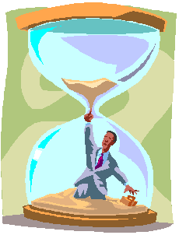

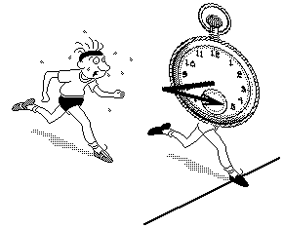
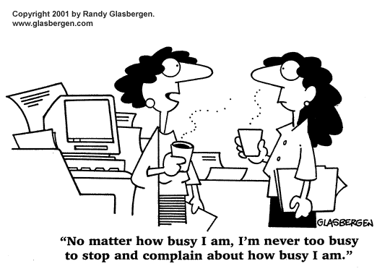

Goal Setting

Slide 2
Overview
Goal setting theory and practice
Managing time
From material to happiness perception

Slide 3
Goals and Performance
Focus
“Being focused on a task produces organization for efficiency both within the organism and in the environment” Abraham Maslow
Resilience
Beliefs as self-fulfilling prophecies (knapsack)
Words create worlds
Concepts conceive

Slide 4
Concerning all acts of creation there is one elementary truth, the ignorance of which kills countless ideas and splendid plans: That the moment one definitely commits oneself, then providence moves too.
All sorts of things occur to help one that would not have otherwise occurred. A whole stream of events issues from the decision, raising in one’s favor all manner of unforeseen incidents and meetings and material assistance which no man would have dreamed would come his way.
I have learned a deep respect for one of Goethe’s couplets:
“Whatever you can do, or dream you can, begin it! Boldness has genius, magic, and power in it.
W.H. Murray

Slide 5
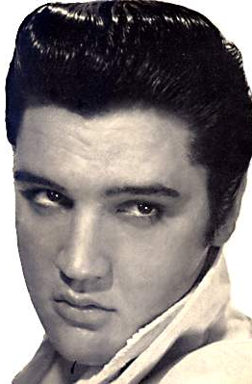
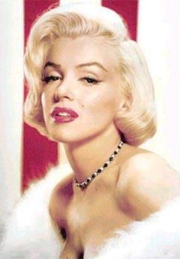
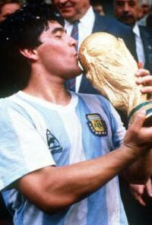
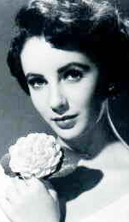
Goals and Wellbeing
Liberating
Future goals as means; present experiences as ends
The case of unhappy achievers

Slide 6
Happiness is not about making it to the peak of the mountain, nor is it about climbing aimlessly around the mountain; happiness is the experience of climbing toward the peak.
“Contemporary researchers emphasize that it is the process of striving after goals—rather than goal attainment per se—that is crucial for happiness and positive affectivity.”
David Watson
“Happiness grows less from the passive experience of desirable circumstances than from involvement in valued activities and progress toward one’s goals.”
Myers & Diener

Slide 7
Live not for battles won.
Live not for the-end-of-the-song.
Live for the along.
Gwendolyn Brooks

Slide 8
Self-Concordant Goals
Aligned with personal interests and values
Freely chosen goals
‘Want to’ vs. ‘Have to’
“What do you really, really want to do?”
Life is too short to do what I have to do; it’s barely long enough to do what I want to do.
“[Becoming self concordant] is a difficult skill, requiring both accurate self-perceptual abilities and the ability to resist social pressures that may sometimes push one in inappropriate directions.” Sheldon & Houser-Marco (2001)

Slide 9
The Benefits of Self-Concordance
Increase in wellbeing
“Having a strong sense of controlling one’s life is a more dependable predictor of positive feelings of well-being than any of the objective conditions of life we have considered.”
Angus Campbell

Slide 10
The Benefits of Self-Concordance
Increase in wellbeing
Increased likelihood of success
Entering a positive upward spiral
Trickle effect
“Individuals pursuing self-concordant goals were ultimately able to exceed the level of academic achievement predicted by their ACT scores, even though most goals were not directly class- or grade-related. This finding suggests that those people who can identify sets of goals that well represent their implicit interests and values are indeed able to function more efficiently, flexibly, and integratively across all areas of their lives.”
Sheldon & Eliot (1999)

Slide 11
The Benefits of Self-Concordance
Increase in wellbeing
Increased likelihood of success
Entering a positive upward spiral
Trickle effect
Health (Langer, 1989)
Freedom vs. oppression

Slide 12
Work Orientation
 | Motivation | Work as… | Expectation | Looking forward to
JOB
CAREER
CALLING

Slide 13
Work Orientation
 | Motivation | Work as… | Expectation | Looking forward to
JOB | Paycheck | Chore / necessity | None | Friday / vacation
CAREER
CALLING

Slide 14
Work Orientation
 | Motivation | Work as… | Expectation | Looking forward to
JOB | Paycheck | Chore / necessity | None | Friday / vacation
CAREER | Money and advancement | Race | Prestige and power | Next promotion
CALLING

Slide 15
Work Orientation
 | Motivation | Work as… | Expectation | Looking forward to
JOB | Paycheck | Chore / necessity | None | Friday / vacation
CAREER | Money and advancement | Race | Prestige and power | Next promotion
CALLING | Thing in itself / self-concordant goals | Mission / vocation / passion / privilege | Better world / fulfillment | More work

Slide 16
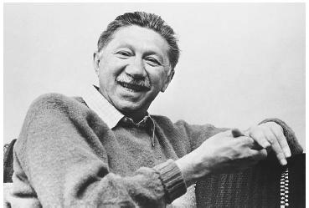
“The most beautiful fate, the most wonderful good fortune that can happen to any human being, is to be paid for doing that which he passionately loves to do.”
Abraham Maslow

Slide 17
The Three Question Process (TQP)
What is meaningful to me? What is important to me?
What is pleasurable to me? What do I enjoy doing?
What are my strengths? What am I good at?

Slide 18
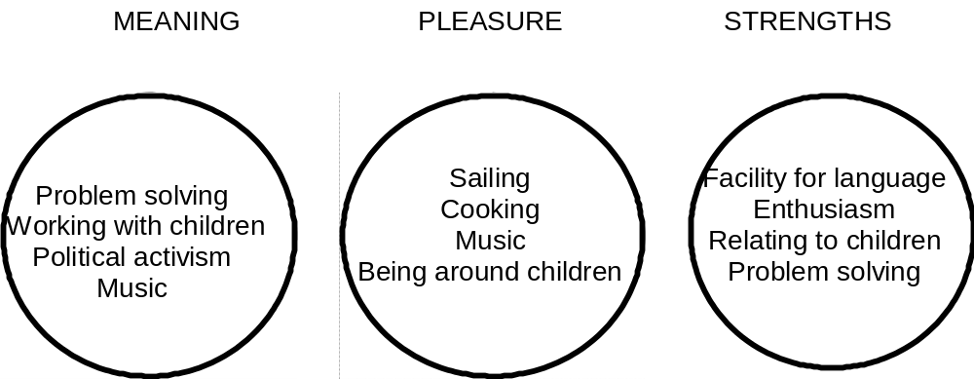

Slide 19
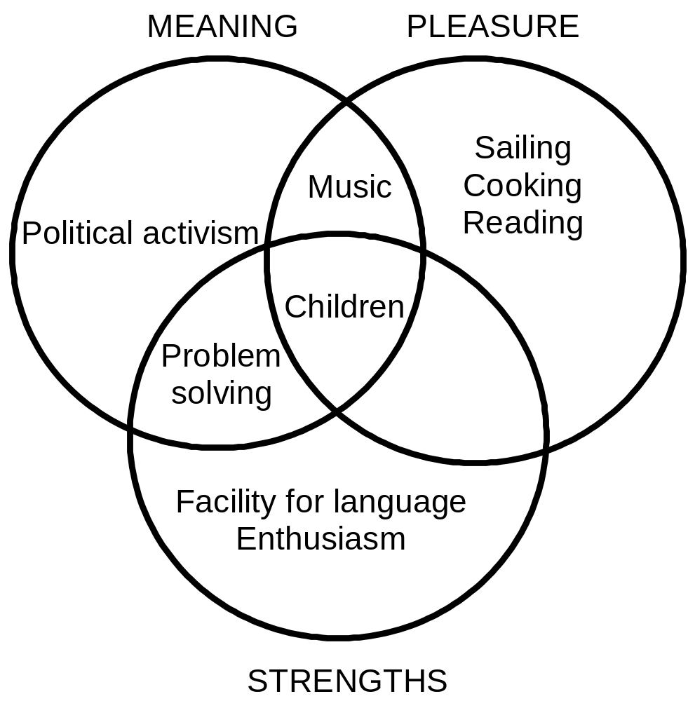

Slide 20
Flow (Mihaly Csikszentmihalyi)
“A dynamic state that characterizes consciousness when experience is attended to for its own sake.”
High performance and high satisfaction
Motivation
Creativity
Self-esteem
Happiness

Slide 21
Optimal Levels of Challenge
Flow
Skill Level
Boredom
Anxiety
Frustration
Task Difficulty

Slide 22
Too Easy?
The need for challenge (Bexton et al., 1954)
Stretch goals (Locke, 2002)
“The best moments usually occur when a person’s body or mind is stretched to its limits in a voluntary effort to accomplish something difficult and worthwhile”
Mihaly Csikszentmihalyi
Big, hairy, audacious goals (Collins & Porras, 1994)

Slide 23


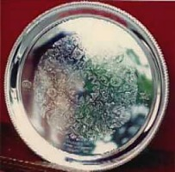
The Underprivilege of Privilege
“It is doubtful whether any heavier curse could be imposed on man than the complete gratification of all his wishes without effort on his part, leaving nothing for his hopes, desires or struggles.”
Samuel Smiles

Slide 24
The Underprivilege of Privilege
Pressure to be happy
“What right do I have to be unhappy?”
Feeling of inadequacy and guilt on top of pain
Emotions as the great equalizer
Permission to be human

Slide 25
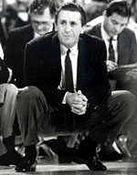
Too Difficult?
Divide and Conquer (short term goals)
Breaking down achievement (Langer, 1989)
“People can imagine themselves taking steps, while great heights seem entirely forbidden.”
Ellen Langer
Pat Riley

Slide 26
Clear Sense of Direction
Immediate feedback
Written plan (Claypool & Cangemi, 1983)
Specific goals (Ajzen & Fishbein, 1982)
Setting lifelines (Tami, 1999)
  goals in-spire
  goals are life-enhancing
“Sound, sound the clarion, fill the fife!
To all the sensual world proclaim,
One crowded hour of glorious life
Is worth an age without a name.”
Sir Walter Scott

Slide 27
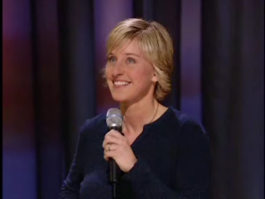

Slide 28
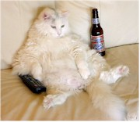
Overcoming Procrastination

Slide 29
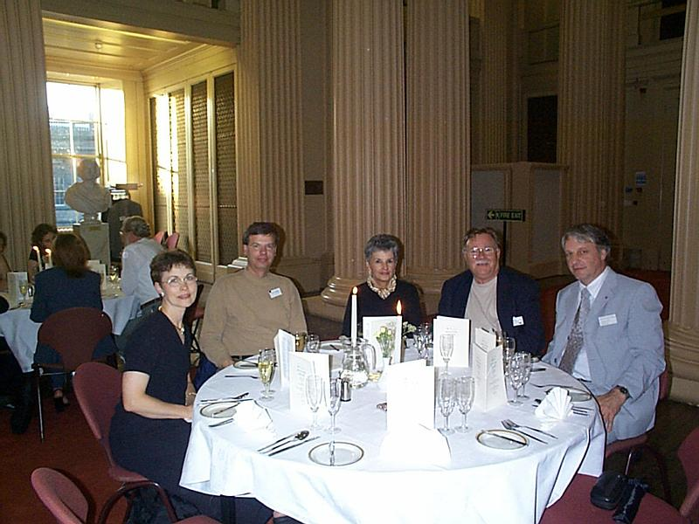

Slide 30
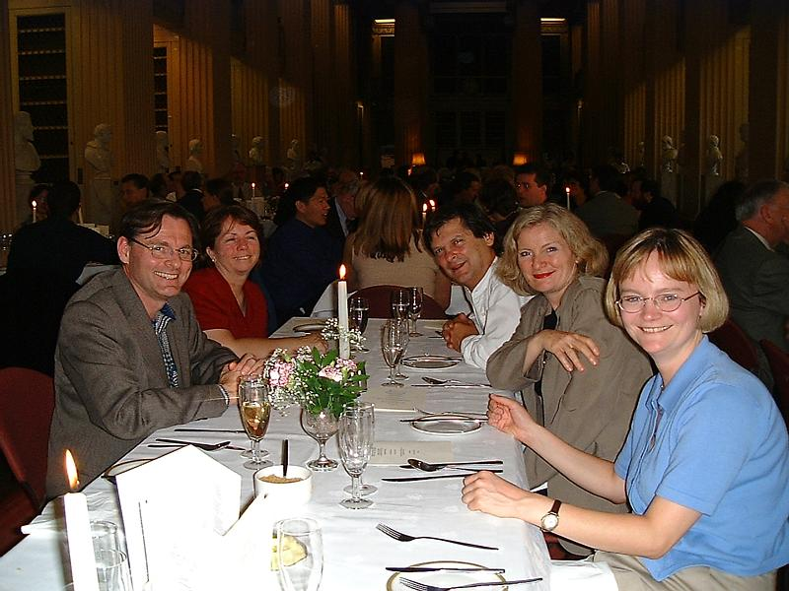

Slide 31
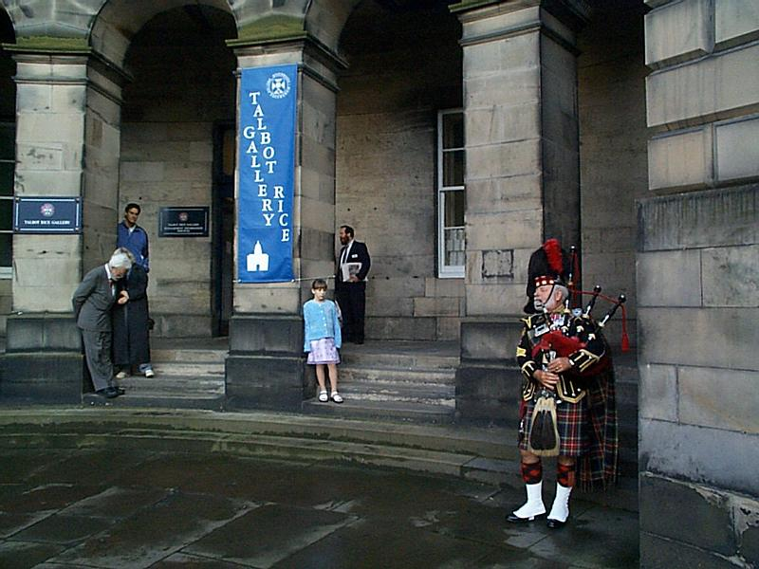

Slide 32
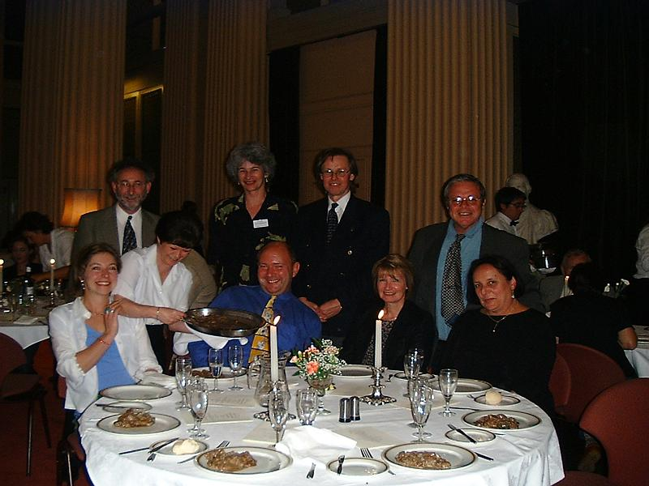

Slide 33
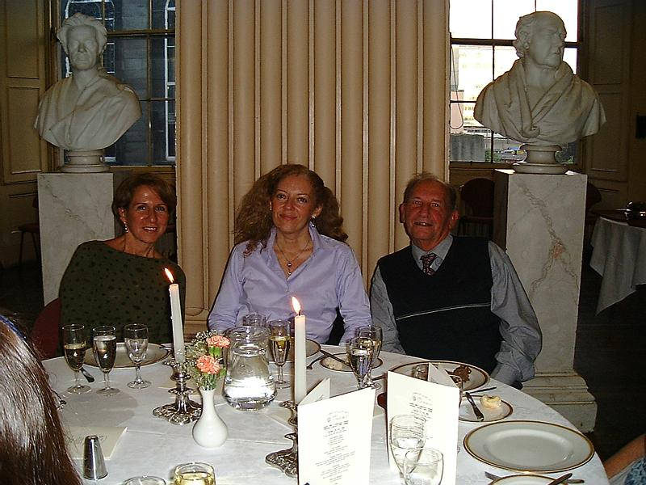

Slide 34
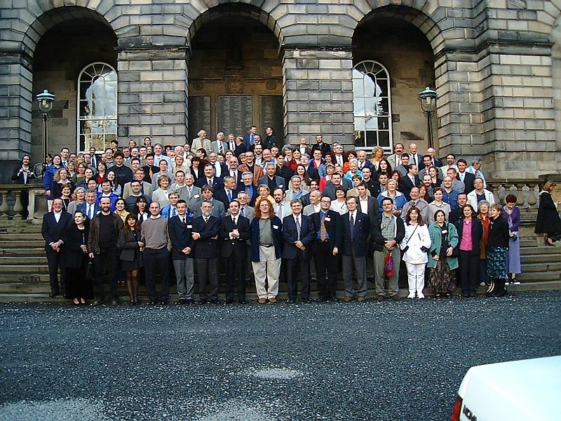

Slide 35
Overcoming Procrastination
The 5-minute take off
Reward yourself
Go public
The team approach
Goals, plans, lists
Permission to re-create

Slide 36
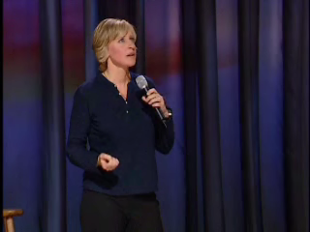

Slide 37
Time Out!
“In a recent national survey of 13,500 college students, nearly 45 percent reported being so depressed that they had difficulty functioning, and 94 percent reported feeling overwhelmed by everything they had to do.”
Richard Kadison
Too much
to do
Stress (feeling
Overwhelmed)
Depression

Slide 38
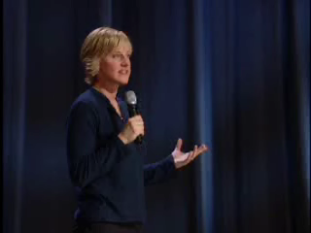

Slide 39
Time Out!
“In a recent national survey of 13,500 college students, nearly 45 percent reported being so depressed that they had difficulty functioning, and 94 percent reported feeling overwhelmed by everything they had to do.”
Richard Kadison
Too much
to do
Stress (feeling
Overwhelmed)
Depression
TBD: Too Busy Disorder (DeGenerous, 2003)

Slide 40
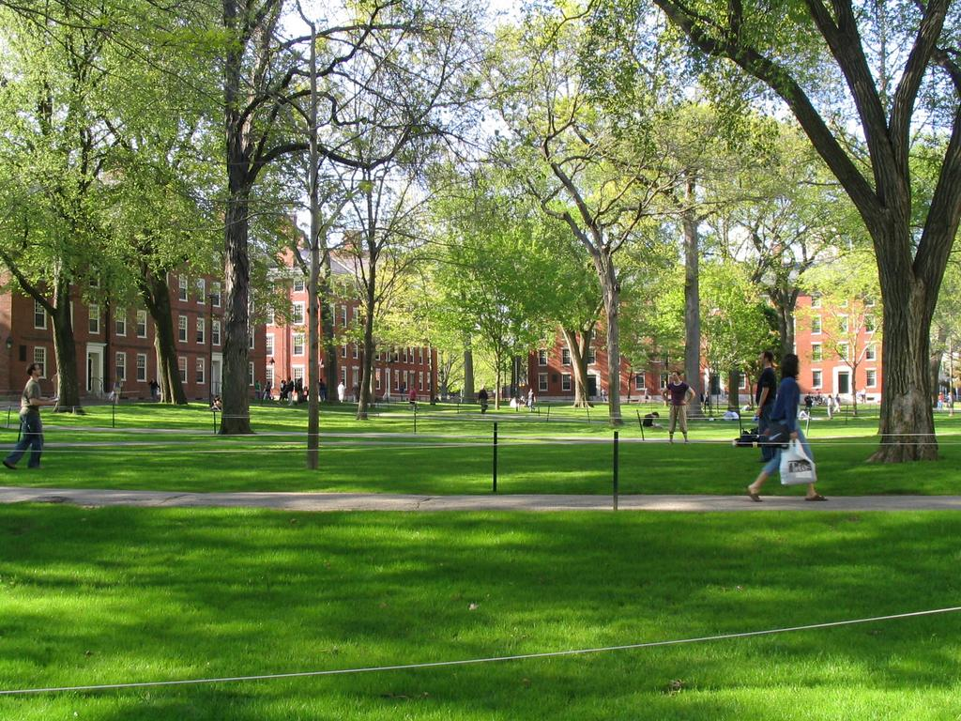
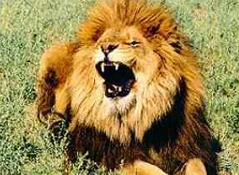
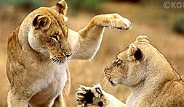

Slide 41
Simplify!
Do less, not more
“Love and sex are affected negatively by stress… If we can help people to simplify their lives, thus reducing their stress levels, it is very likely that people’s relationships would be enriched greatly. Moreover, the positive aspects of their lives would be enriched accordingly.”
Susan & Clyde Hendrick (2002)

Slide 42
Simplify!
Do less, not more
Quantity affects quality
Say “yes” by saying “no”
Optimum levels of simplicity
“Work expands to fill the time available for its completion.”
Cyril Northcote Parkinson
“I can do a year’s work in nine months, but not in twelve.”
JP Morgan

Slide 43
“Simplicity, simplicity, simplicity! I say let your affairs be as two or three, and not a hundred or a thousand; instead of a million count half a dozen... In the midst of this chopping sea of civilized life, such are the clouds and storms and quicksands and the thousand-and-one items to be allowed for, that a man has to live, if he would not founder and go the bottom and not make his port at all, by dead reckoning, and he must be a great calculator indeed who succeeds. Simplify. Simplify .” Henry David Thoreau

Slide 44
Material Perception
Material as the highest end
“Society tells us the only thing that matters is matter—the only things that count are the things that can be counted.” Laurence G. Boldt
Counting activities
Counting publications
Counting money

Slide 45
Obsession With Material Wealth
“The inherent vice of capitalism is the unequal sharing of blessings; the inherent virtue of socialism is the equal sharing of miseries.”
Winston Churchill
Making the most of our blessings?
1968: 41% to make a lot of money
83% to develop a meaningful philosophy of life
1997: 75% to make a lot of money
41% to develop a meaningful philosophy of life

Slide 46
The Consequences
Money can’t buy you happiness (Diener, 1999)
“The Dark Side of the American Dream” (Kasser & Ryan, 1993)
  lower likelihood of self-actualization
  higher levels of distress, depression, anxiety
  lower levels of happiness
  poorer physical health
Replicated in Singaporean business-school (Kasser & Ahuvia, 2002)
A caveat

Slide 47
Happiness Perception
Happiness as the highest end
“Happiness is the meaning and purpose of life, the whole aim and end of human existence.”
Aristotle
“Whether one believes in religion or not, whether one believes in this religion or that religion, the very purpose of our life is happiness, the very motion of our life is towards happiness.”
Dalai Lama
The ultimate currency

Slide 48
Happiness Perception in Our Lives
“People seeking greater well-being would be well advised to focus on the pursuit of (a) goals involving growth, connection, and contribution rather than goals involving money, beauty, and popularity and (b) goals that are interesting and personally important to them rather than goals they feel forced or pressured to pursue.” Sheldon et al. (2004)
Asking the right questions
Framing makes all the difference

Slide 49
The Happiness Revolution
Inside out (Vs. outside in)
Non-zero-sum game
“Thousands of candles can be lighted from a single candle, and the life of the candle will not be shortened. Happiness never decreases by being shared.”
The Buddha
Peaceful revolution

Slide 50
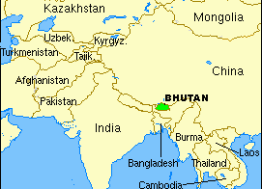
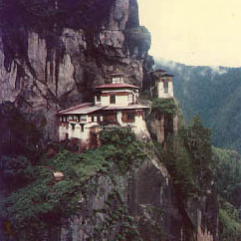
Implications for Politics
Wars mostly over material possessions
Government’s role
  Creating conditions for pursuing happiness
  Ensuring freedom
  Educating

Slide 51
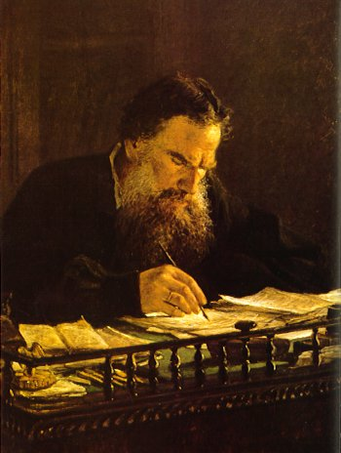
“Everybody thinks of changing humanity and nobody thinks of changing himself.”
Leo Tolstoy

Slide 52
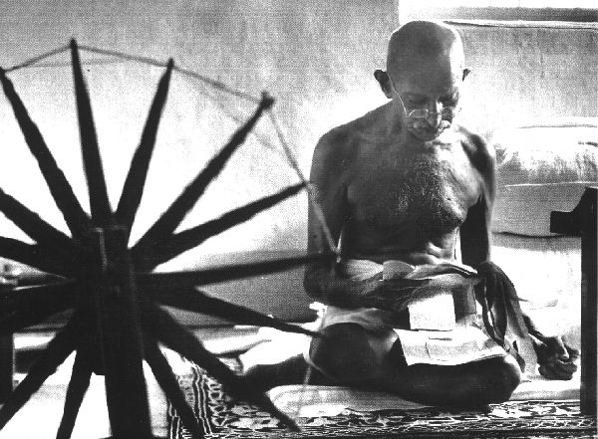
“Be the change you want to see in the world.”
Gandhi

Slide 53
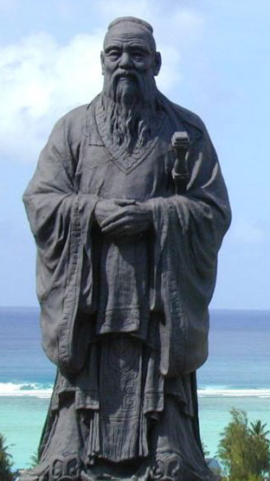
“From the Son of Heaven down to the common people, all must regard cultivation of the personal life as the root. A disordered root cannot grow into ordered branches. If what is near is neglected, how can one take care of what is far away?” Confucius

Slide 54
Bibliography and Recommendations
Csikszentmihaly, M. (1991). Flow: The Psychology of Optimal Experience, 71-93. Harper Collins Publishers.
Kasser, T., & Ryan, R. M. (1993). A dark side of the American dream: Correlates of financial success as a central life aspiration. Journal of Personality and Social Psychology, 65, 410-422.
Locke, E. A. (1998). “Study Methods and Motivation.” New Milford, CT: Second Renaissance Books.
Mumford, M. D., Schultz, R. A. & Van Doorn, J. R. (2001). Performance in Planning: Processes, Requirements, and Errors. Review of General Psychology, 5, 213-240.
Sheldon, K. M. & Elliot, A. J. (1999). Goal striving, need-satisfaction, and longitudinal well-being: The Self-Concordance Model. Journal of Personality and Social Psychology, 76, 482-497.
Self-test based on Stephen Covey’s distinction between urgent and important: http://www.franklincovey.com/ez/urgencyanalysis/ua-prof.html

